Slide 1
New Perspectives on Brazilian Ethno-racial Relations from PERLA-Brasil
Graziella Mores Silva – UFRJ
Marcelo Paixão - UFRJ

Slide 2
Brazil has a long tradition in collecting information over his population disaggregated by color or race
Demographic Census: 1872, 1890, 1940, 1950, 1960, 1980, 1991, 2000, 2010

Slide 3
Brazilian census categories use to be based on phenotypic features: skin color
what is your color or race? (self-definition)
Branco (White), Preto (Black), Pardo (Brown), Amarelos (Asian)
Since 1991 Census the category Indigenous has been incorporated in the Brazilian census

Slide 4
In the recent period, the Brazilian demographic and statistical system progressively have been incorporating the variable color or race
Pnad, Pme, Sim, Sinasc, CadUnico, Rais, Caged, so on...

Slide 5
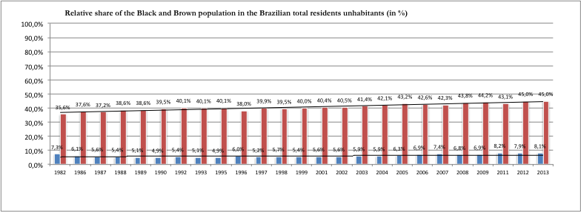
Progressive increasing of the Black and Brown´ share in the Brazilian total residents
2012: Law 12,711 / 2012
1st Brazilian University has adopted Affirmative action for undergraduate access; Durban Conference Against Racism
2003: Creation of SEPPIR (Racial Equality Policies Ministry)

Slide 6
The results of Perla data debated with this trajectory and several previous studies that discussed this matter
Using official categories
Accomplishing new researches with alternatives methods and questions

Slide 7
So the main challenge of Perla Brazil research was how to bring new findings over the race categories…
...And its effects over racial inequality: different classificatory systems use to lead different outcomes

Slide 8
Our findings can be divided in three blocks:
Outlook over different classificatory system using alternatives questions
Perception about ethnic and racial identity and discrimination
Racial inequality measures following the alternatives classificatory system

Slide 9
Classificatory systems to measure color or race of the Brazilian population

Slide 10
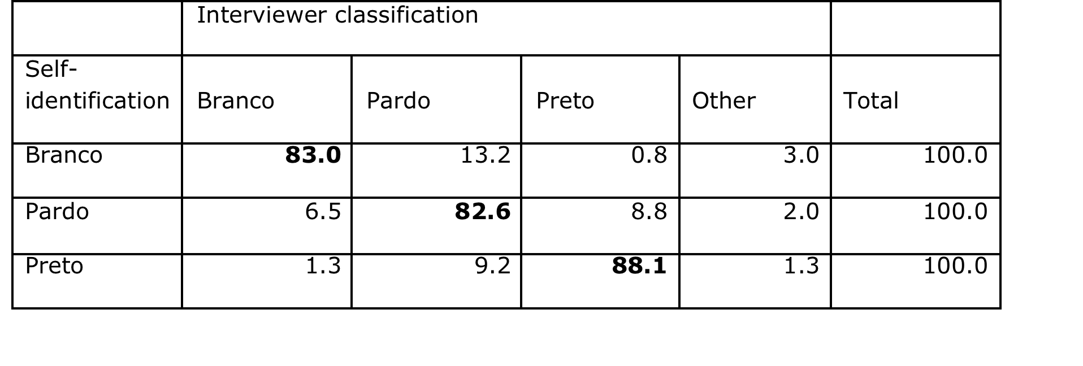
Interviewees' racial identification vs. Interviewers' categorization
In this case our findings have converged with former studies that used similar classification method

Slide 11
Percentage of negro interviewees, according to different indicators
Using different system to classify who could be considered Afrodescendant we found different possibilities. Officially Preto + Pardo in Brazil share almost 51% of the population

Slide 12
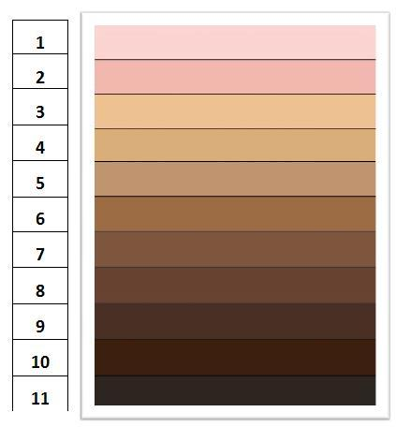
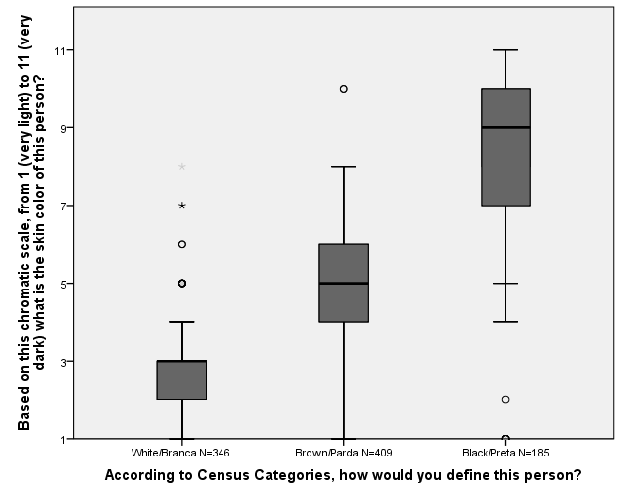
Interviewers’ classification relying on IBGE categories and Color Palette
It is worth to note the range of the palette color according with self-declaration. Convergences and differences

Slide 13
Perception about national and ethnic identity Perception about discrimination and ethnic and racial advantages or disadvantages

Slide 14
Perception of Differences across Ethnic-racial Groups

Slide 15
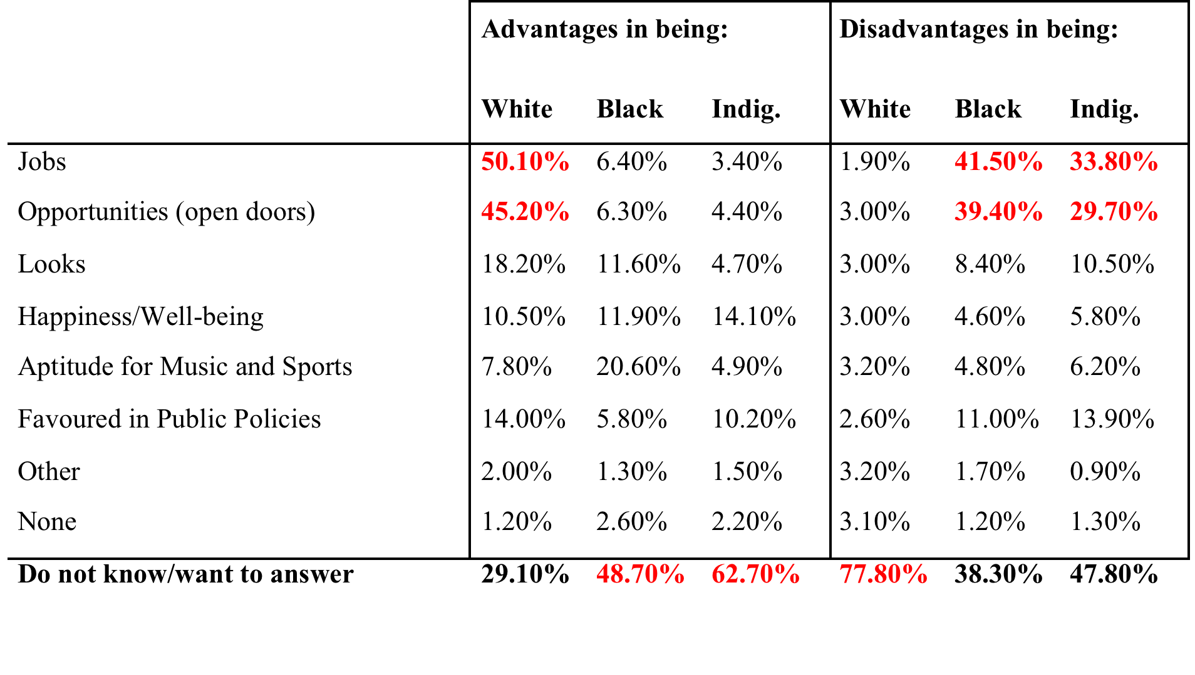
Advantages and Disadvantages about being White, Black and Indigenous

Slide 16
% of respondents who perceived discrimination (at least a few times) according to the context and by their IBGE racial identification

Slide 17
Racial inequality following different classificatory system of ethnic and race definition

Slide 18
Average years of Education by self-identification and classification by interviewer

Slide 19
Education (average years of schooling) by classification of phenotype (hair and skin color according to the Color Palette) by interviewer

Slide 20
Main finding is that the inequality is bigger when we use Color Palette
So, if we compare this outcome with inequality coming from self-identification the first one was more intensive

Slide 21
Maybe a good hypothesis to dialogue with recent dropping movement in the color and race inequality in Brazil.
We can hint that at least in part this recent trend might be affected from the new identities of some part of Brazilian population:
From White to Brown and from Brown to Black.

Slide 22
Muchas gracias Muito obrigado!!!!

